Slide 1
How to Apply for Open Access
There are two possible routes to Gold Open Access:
Gold for Gold
You use an Open Access voucher after peer-review and acceptance. The final article of record is made available to all, immediately, via our website without any barriers to access, without paying the article processing fee.
Paid Open Access
You pay an article processing fee after peer-review and acceptance. On receipt of payment the final article of record is made available to all, immediately, via our website without any barriers to access.

Slide 2
How to Apply for Open Access
Open Access applications should be submitted as soon as possible after acceptance.
There are three main parts to an Open Access application:
Gold for Gold voucher code
Or payment;
Online application;
Open Access Licence to Publish form.

Slide 3
Gold for Gold
The Gold for Gold initiative rewards all institutions that subscribe to RSC Gold with voucher codes to make papers Open Access, free of charge.
Gold for Gold Applications
Contact your institution’s Open Access team or Library to request a Gold for Gold voucher.
Complete the online application form.
http://www.rsc.org/Publishing/Journals/OpenScience/Gold4Gold.asp
Your article must have been accepted for publication before an application can be processed.

Slide 4
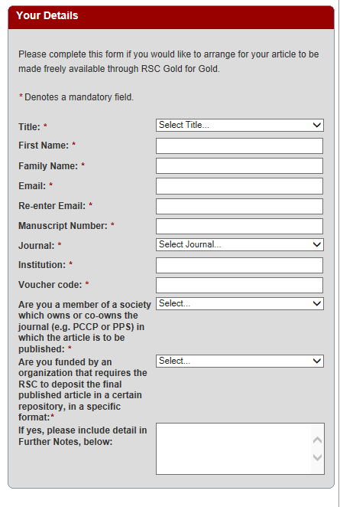
Gold for Gold
Contact details
DOI number (CXJJXXXXXL)
Full name of Institution
Voucher Code: (Au-XXXXXX)
Further Notes: add funding agency information if your funding agency mandates Gold Open Access.

Slide 5
Paid Open Access
Authors can choose to pay an article processing fee to make their article Open Access.
The fees for Open Access are dependent on the article type. Information regarding the fees can be found on our website.
http://www.rsc.org/Publishing/Journals/OpenScience/Fees.asp
If you do not have a Gold for Gold voucher and you wish to apply for paid Open Access, please complete the online form.
http://www.rsc.org/Publishing/Journals/OpenScience/form.asp

Slide 6
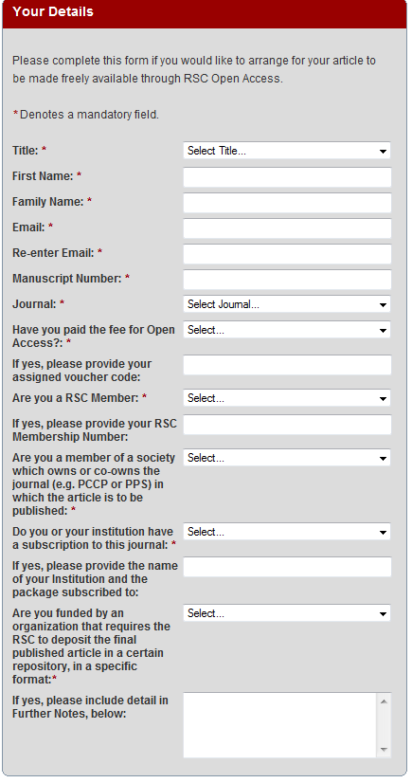
Paid Open Access
Complete contact details and manuscript number as you would for the Gold for Gold application
15% discount for RSC members and institutions with RSC Gold subscription
Funding agency

Slide 7
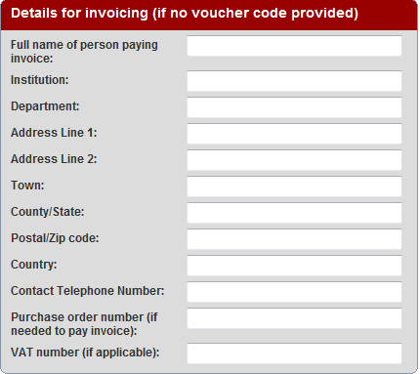
Paid Open Access
Full name of the person handling the invoice
Full name of the institution as well as the full address. Please avoid abbreviations.
Contact telephone number with area code
Purchase order number
If you are situated in an EU member state or Canada please provide VAT details.

Slide 8
A new Licence to Publish
On completion of the online application form you should also complete and return a scanned copy of the Open Access Licence to Publish form to RSC1@rsc.org.
An Open Access licence will replace the licence completed at submission.
We offer two Creative Commons licences, which allow compliance with UK funding agency mandates.

Slide 9
Choosing a Licence
We offer a choice between CC BY and CC BY-NC.
The choice of licence depends on two main considerations:
Preference of your funding agency, if any.
Whether you wish to restrict use of the work to non-commercial (‘NC’) purposes.
Articles published in PPS, PCCP or NJC have licences specific to the journal.

Slide 10
Where to find the Licence
All Open Access licence forms can be downloaded here（http://www.rsc.org/Publishing/copyright/open-access-licence-to-publish-journals.asp
）.
CC BY Licence for most journals
CC BY Licence for Physical Chemistry Chemical Physics
CC BY-NC Licence for most journals

Slide 11
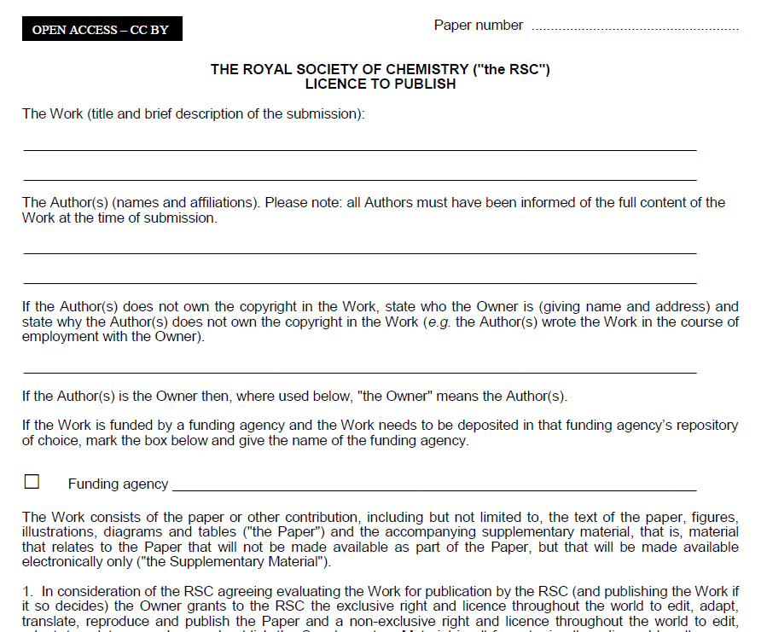
Completing the Licence
CXJJXXXXXL
e.g. Wellcome Trust

Slide 12
Sending the Licence
Please photocopy or take a high quality picture of the completed licence form.
You should ensure that all sections of the form are clearly visible, otherwise you may be requested to re-send it.
Send the form as an email attachment to RSC1@rsc.org, quoting the paper number.

Slide 13
Successful Applications
The application is successful when:
An online application has been received;
A valid Gold for Gold voucher has been provided
OR payment has been confirmed;
The Licence to Publish form has been successfully completed.

Slide 14
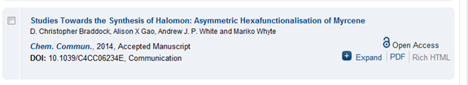
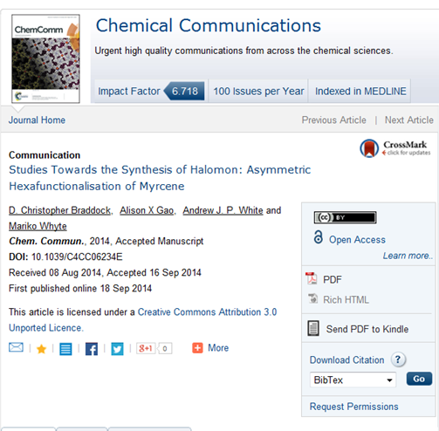
Successful Applications
Creative Commons Licence type

Slide 15
FAQs
My paper has already been published. Can I apply for Open Access? Yes.
Can I make my book chapter Open Access? No, Open Access is available only for journal articles.
My article is in peer review. Can I apply for Open Access? Please wait until your article has been formally accepted for publication.
I have just submitted a paper and I would like to publish Open Access. Should I complete the normal Licence to Publish form? Yes. Please complete the first licence when requested at submission to avoid delays at publication.

Slide 16
Contact
Please contact our Open Access administration team at RSC1@rsc.org or your journal editorial office.
We will be happy to answer any queries you may have regarding our options for Open Access.

